Slide 1
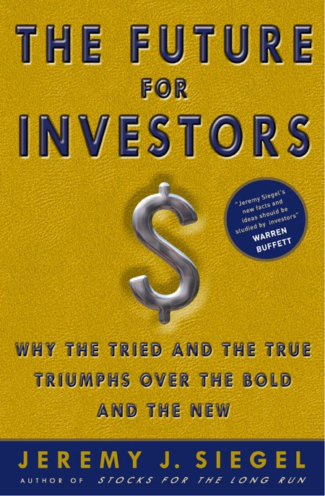
Why did the Fed Get It So Wrong? Prof. Jeremy J. Siegel ~ The Wharton School For Q Group ~ September 2022
Notes:
Hello, my name is Prof. Jeremy Siegel. Welcome to today’s presentation.

Slide 2
Fed Caused Current Inflation
Far too rapid money growth after pandemic.
Money growth (M2) in 2020 the fastest on record
Essentially monetized the government debt floated for the COVID relief packages, which were substantial and far greater than other countries.
Third worst monetary policy in 110-year history of Fed (#1 Great Depression, #2 Inflation of 1970s)

Slide 3
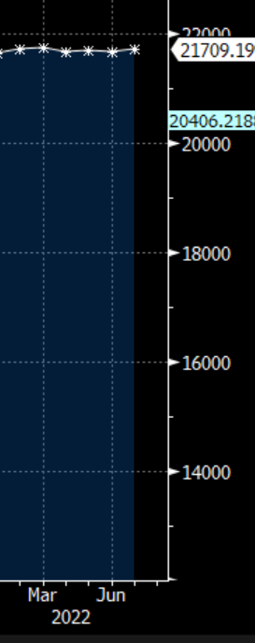
M2 Money Growth
M2 growth stopped in March
2016-2021
+11.9% per year
Jul 2020-Feb 2022
5.3% per year
+17.5%
March to July
2020
1970-2021
High Inflation Period
M2 9.6% per year /1970-1986
CPI 7.0% per yr/ 1970-1986
Lower Inflation Period
M2 5.4% per year /1986-2020
CPI 2.6% per year 1986-2020
Source: Bloomberg as of 11/29/2021
Source: Bloomberg as of 11/29/2021
Source: Bloomberg March-April 2022

Slide 4
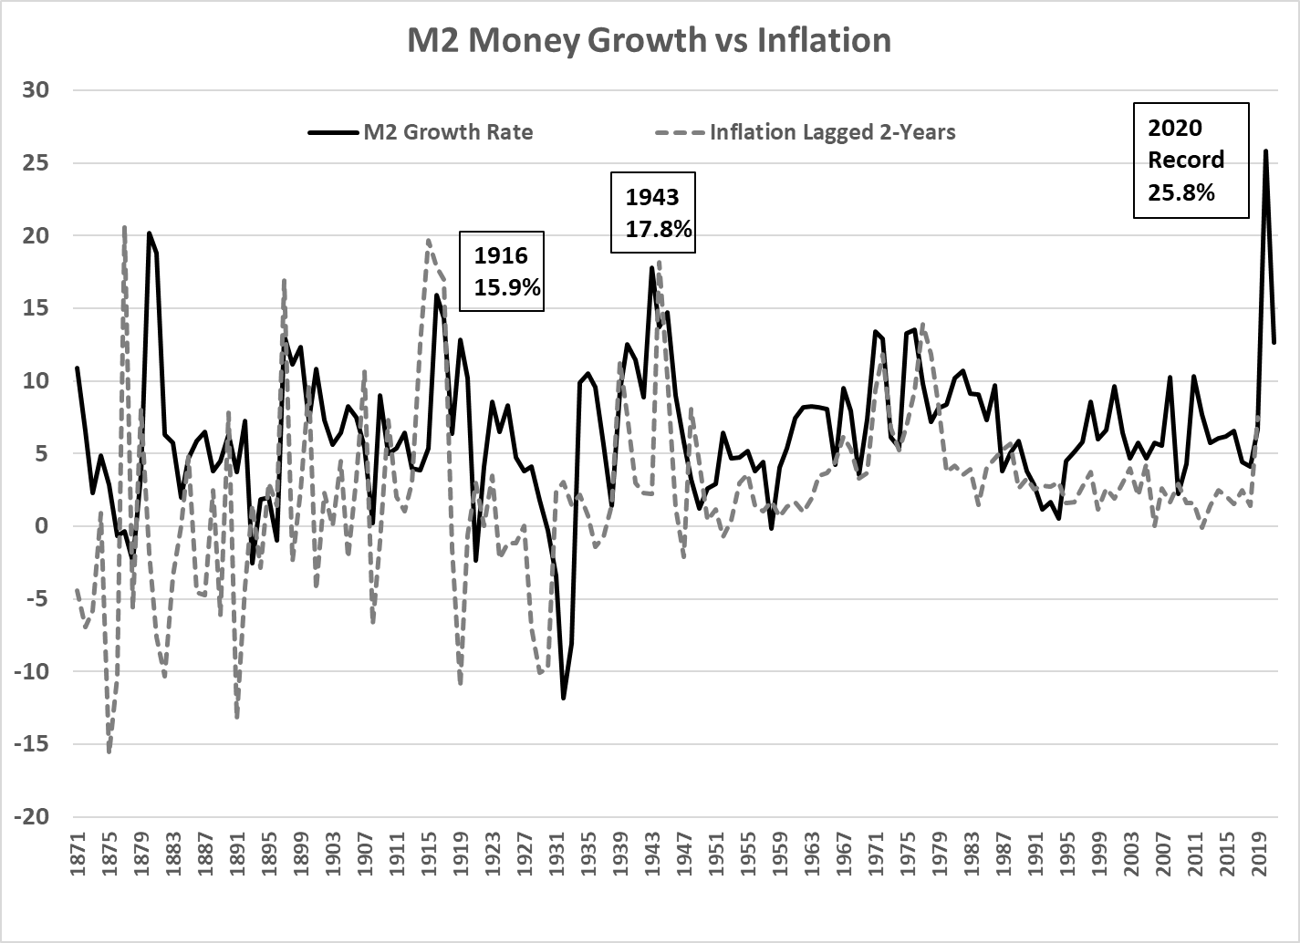
2020 All-Time Record Money Growth
Source: Bloomberg, as of 12/31/21

Slide 5
“Groupthink” at Fed
It is surprising there was little or no dissent from the ultra dovish policy.
In September 2021 FOMC meeting, 8 of the 16 FOMC members that issued funds rate projections “The Dot Plot“ indicated that no increase whatsoever was needed in 2022, 5 thought one 25 bp increase was necessary, and 3 (the most hawkish) though that two 25 bp increases were necessary.
This consensus prevailed despite the largest monetary increase in history, a housing boom that surpassed the one preceding the financial crisis and the tightest job market is post-war history

Slide 6
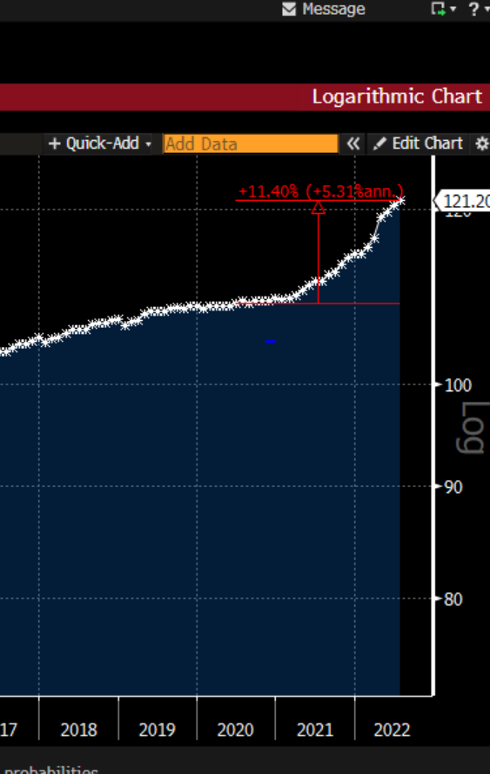
Housing Price Gains exceeded 2003-6 bubble
Case Shiller Housing Up 44.5%
CPI Housing up 11%

Slide 7
Job Openings

Slide 8
Why?
Misled by “false alarms” issued by a number of economists (including John Taylor) that followed the QE cycles initiated by Ben Bernanke. Confused the importance of the monetary base and M2
Much of the staff not schooled in classical monetary theory, produced studies that showed no relation between money and inflation.
Powell had little macro background and relies on staff projections.
Powell himself dismissed a connection between money and inflation in sworn Senate testimony in February 2021.

Slide 9
Effect on Financial Markets
Stocks are real assets, completely overcome inflation in long run.
But real assets react to Fed tightening since such tightening raises the real interest rate.
Since earlier this year, 10-year TIPS raise has risen about 200 bps, from minus 1.1% to almost +80 bps.
This can explain virtually all of the drop in stock prices in 2022.

Slide 10
Total Real Return Indexes
January 1802 – June 2022
Stocks: 6.7% Real
Bonds: 3.5% Real
Bills: 2.5% Real
Gold: 0.6% Real
Dollar:-1.4%Real
Source: Siegel, Jeremy, Stocks for the Long Run (2014), With Updates to 2022
Past performance is not indicative of future results. You cannot invest directly in an index.
Notes:
This chart shows the long term growth of a $1 in the major asset classes: stocks, bonds, bills, gold, and the dollar, based on research I conducted for my book Stocks for the Long Run (1994, 1998, 20002), and it shows updated returns based on my own databases.
The chart shows the value of these assets measures on a “Real” , or after-inflation basis.
The values each asset class grows to can be seen in the chart above.
This chart shows the long term cumulative growth of $1 from major asset classes: stocks, bonds, bills, gold, and the dollar, as well as the average annual returns that accumulate to those long-term wealth gains.

Slide 11
World Wide Steady Decline in Real Rates

Slide 12
What should the Fed have done?
The Fed should not have accommodated all of the government’s overspending on Covid Crisis.
If the Treasury was forced to go to the bond market, interest rates would have risen much earlier and much of this inflation would have been avoided.
The Fed was created to “take away the punch bowl when the party got good.” Instead, they continued to spike the drinks long after it became apparent the economy was overheating.

