Slide 1
Who Uses Corporate Sustainability Reports?
SUZANNE BURZILLO, UNIVERSITY OF Southern CALIFORNIA
MATTHEW SHAFFER, UNIVERSITY OF Southern CALIFORNIA
Richard Sloan, UNIVERSITY OF Southern CALIFORNIA

Slide 2
Defining Sustainable Development
‘Development which meets the needs of the present without compromising the ability of future generations to meet their own needs.’
[World Commission on Sustainable Development, 1987]

Slide 3
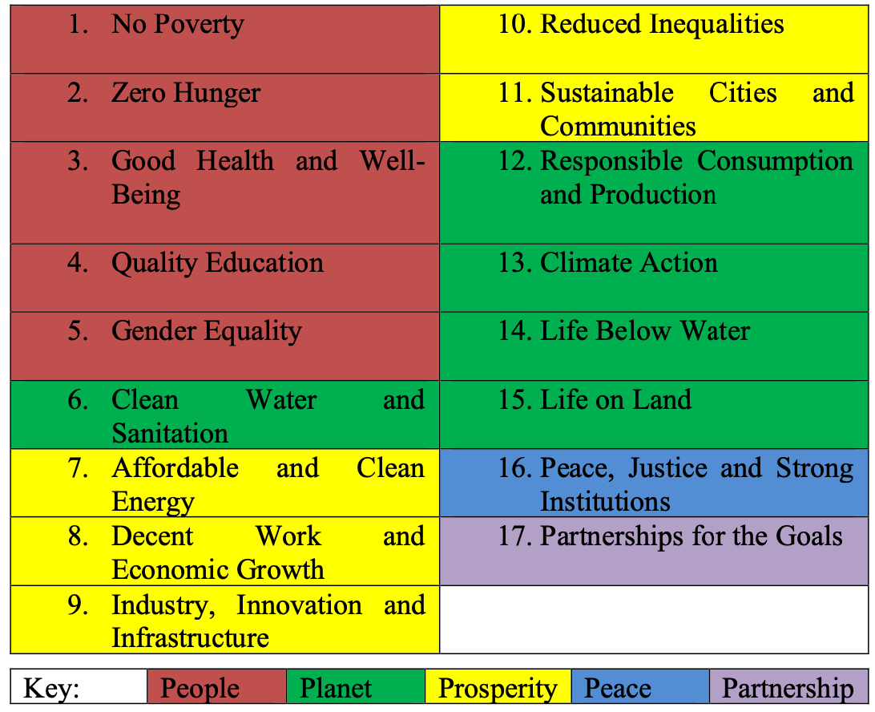
The UN’s 17 Sustainable Development Goals (SDGs)

Slide 4
How Can Businesses Impact Sustainable Development? (adapted from GRI 1)
Environmental:
Managing the business impact on the planet, including living organisms and non-living elements such as air, water, land and ecosystems.
Social:
Managing the business impact on individuals and groups including employees, communities, vulnerable groups and society.
Economic:
Managing the business impact on economic systems at the local, national and global levels.
Governance:
Installing people and procedures to provide strategic guidance for the business, monitor management and ensure the accountability of management to stakeholders.

Slide 5
Two Leading Sustainability Reporting Standard Setters
GRI (Global Reporting Initiative)
GRI is the independent, international organization that helps businesses and other organizations take responsibility for their impacts, by providing them with the global common language to communicate those impacts. We provide the world’s most widely used standards for sustainability reporting – the GRI Standards.
SASB (Sustainability Accounting Standards Board)
SASB Standards guide the disclosure of financially material sustainability information by companies to their investors. Available for 77 industries, the Standards identify the subset of environmental, social, and governance (ESG) issues most relevant to financial performance in each industry.
Effective August 1, 2022, the Value Reporting Foundation–home to the SASB Standards–consolidated into the IFRS Foundation, which established the first International Sustainability Standards Board (ISSB). SASB Standards are now under the oversight of the ISSB. The ISSB will build upon the SASB Standards and embed SASB’s industry-based standards development approach into the ISSB’s standards development process. The ISSB actively encourages preparers and investors to continue to provide full support for and to use the SASB Standards until the SASB Standards become the IFRS Sustainability Disclosure Standards.

Slide 6
Definition of Sustainability
GRI | SASB
ISSB
The objective of sustainability reporting using the GRI Sustainability Reporting Standards is to provide transparency on how an organization contributes or aims to contribute to sustainable development.¹
SASB’s use of the term “sustainability” refers to activities that maintain or enhance the ability of the company to create enterprise value over the long-term.²
Information that gives insight into sustainability-related risks and opportunities that affect enterprise value, providing a sufficient basis for users of general purpose financial reporting to assess the resources and relationships on which an entity’s business model and strategy for sustaining and developing that model depend.³
^{1”}GRI 1: Foundation 2021,” GRI, 2022.
^{2”}SASB Conceptual Framework Exposure Draft,” SASB, 2020.
^{3”}IFRS S1 General Requirements for Disclosure of Sustainability-related Financial Information [Exposure Draft]”, IFRS Foundation, 2022.

Slide 7
Intended Preparers
GRI | SASB
ISSB
Any organization can use the GRI Standards – regardless of size, type, geographic location, or reporting experience. ¹
An entity that is required, or chooses, to prepare general purpose financial statements.³
Public and private companies.²
^{1”}GRI 1: Foundation 2021,” GRI, 2022.
^{2”}SASB Conceptual Framework Exposure Draft,” SASB, 2020.
^{3”}IFRS S1 General Requirements for Disclosure of Sustainability-related Financial Information [Exposure Draft]”, IFRS Foundation, 2022.

Slide 8
Intended Users
GRI | SASB
ISSB
Stakeholders, defined as individuals or groups that have an interest that is affected or could be affected by the organization’s activities (e.g., business partners, civil society organizations, consumers, customers, employees and other workers, governments, local communities, NGOs, shareholders and other investors, suppliers, trade unions, vulnerable groups).¹
Investors, lenders, and other creditors for the purpose of making investment decisions.²
Existing and potential investors, lenders and other creditors.³
^{1”}GRI 1: Foundation 2021,” GRI, 2022.
^{2”}SASB Conceptual Framework Exposure Draft,” SASB, 2020.
^{3”}IFRS S1 General Requirements for Disclosure of Sustainability-related Financial Information [Exposure Draft]”, IFRS Foundation, 2022.

Slide 9
Definition of Materiality
GRI | SASB
ISSB
Topics that represent the organization’s most significant impacts on the economy, environment, and people, including impacts on their human rights.¹
Information is financially material if omitting, misstating, or obscuring it could reasonably be expected to influence investment or lending decisions.²
Sustainability-related financial information is material if omitting, misstating or obscuring that information could reasonably be expected to influence decisions that the primary users of general purpose financial reporting make on the basis of that reporting, which provides information about a specific reporting entity.³
^{1”}GRI 1: Foundation 2021,” GRI, 2022.
^{2”}SASB Conceptual Framework Exposure Draft,” SASB, 2020.
^{3”}IFRS S1 General Requirements for Disclosure of Sustainability-related Financial Information [Exposure Draft]”, IFRS Foundation, 2022.

Slide 10
Main Purpose
To assess the financial information content of sustainability reports incorporating SASB standards that are intended to provide information that is ‘financially material’ and ‘decision useful’ to investors.

Slide 11
Prior Research
Prior ‘value relevance’ research finds an association between stock prices and information conforming with SASB standards
Khan et al. (2016), Spandel et al. (2020), Madison and Schiehll (2021) and Serafeim and Yoon find that the SASB’s financial materiality mapping is associated with improved assessments of sustainability performance.
Grewal et al. (2021) and Schiehll and Kolahgar (2021) find that disclosure of SASB-classified financially material sustainability metrics is associated with increased stock price informativeness.

Slide 12
Hypotheses
We assess the information content of sustainability reports using the standard procedure for assessing the information content of financial reports pioneered by Beaver (1968).
Prediction 1: The announcement of a corporate sustainability report containing SASB metrics is associated with a significant stock price reaction.
Prediction 2: The announcement of a corporate sustainability report containing SASB metrics is associated with abnormally high trading volume.
Prediction 3: When compared to quarterly earnings reports, the announcement of corporate sustainability reports containing SASB metrics is associated with a relatively smaller stock price reaction.
Prediction 4: When compared to quarterly earnings reports, the announcement of corporate sustainability reports containing SASB metrics is associated with relatively lower abnormal trading volume.

Slide 13
Sample Source
Recent surveys indicate that around 90% of large US corporations report on sustainability
Since the SEC does not mandate information on sustainability, most U.S. companies issue separate sustainability reports
In order to isolate reports containing potentially financially material and decision useful information, we focus on reports incorporating SASB standards, as identified on the SASB website.
Start with all reports listed on website as of 9/2/2021

Slide 14
Sample Selection
We further require that each sustainability report is accompanied by a dated public announcement that is issued concurrently with the report (i.e., isolate initial announcement of SASB metrics)
We eliminate any reports that also incorporate the release of traditional financial statement information (e.g., Form 10-K)
We search the company’s website and the EDGAR database and eliminate any companies announcing earnings or releasing Forms 10-Q or 10-K in the 5-day window centered on the sustainability report press release date
Eliminate companies without the required stock market data and earnings announcement dates

Slide 15
Example: Whirlpool
Clicking on Whirlpool Corp links to report
We search for an accompanying press release, which in this case can be found here

Slide 16
Sample Construction

Slide 17
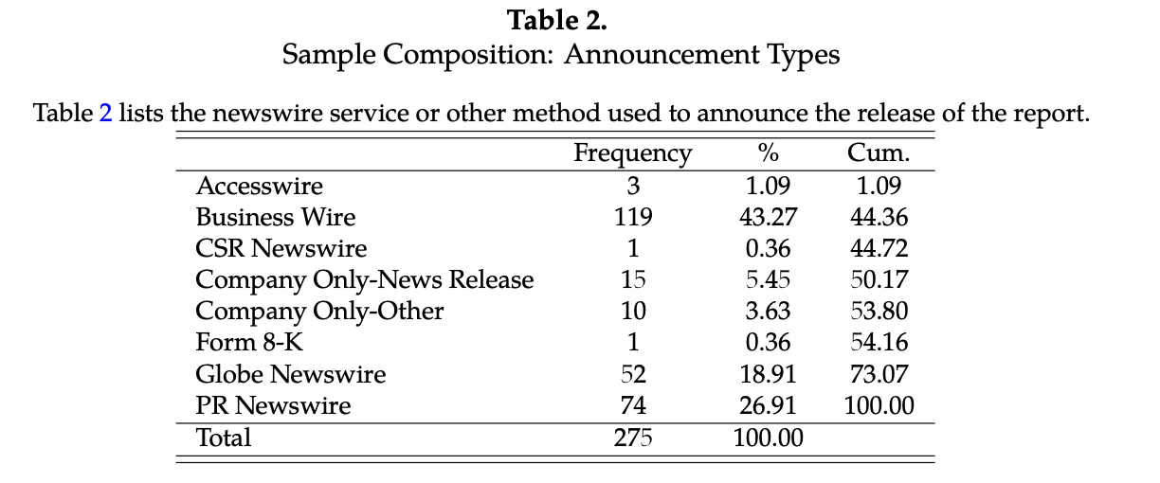
Report Announcement Sources

Slide 18
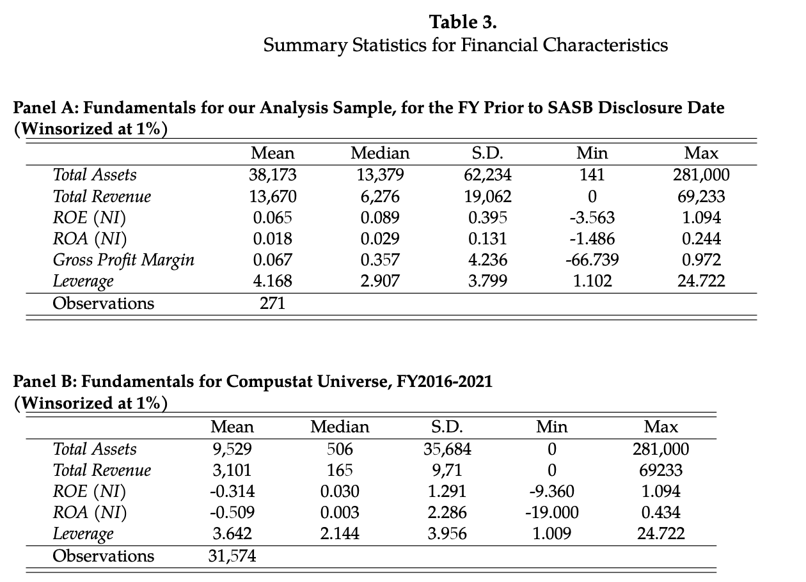
Sample Financial Characteristics

Slide 19
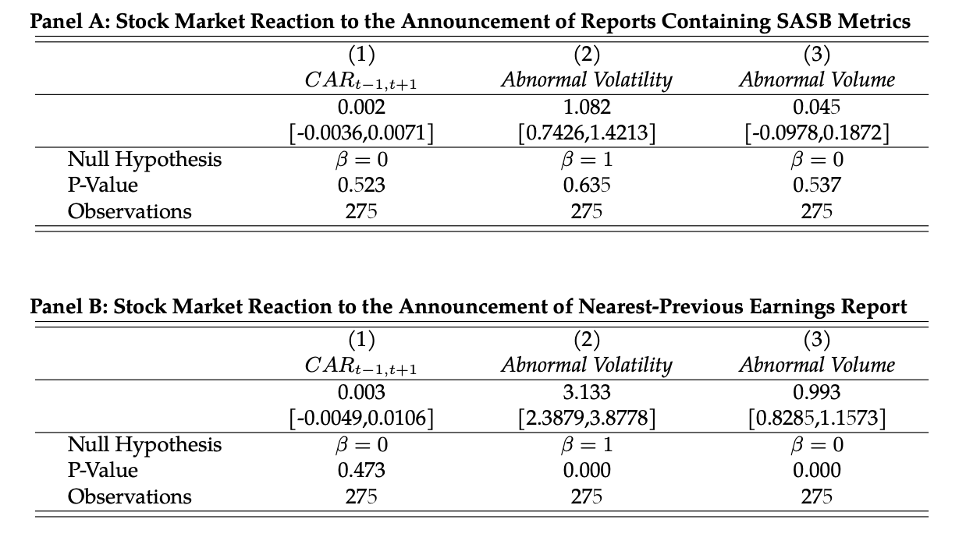
Tests of Predictions

Slide 20
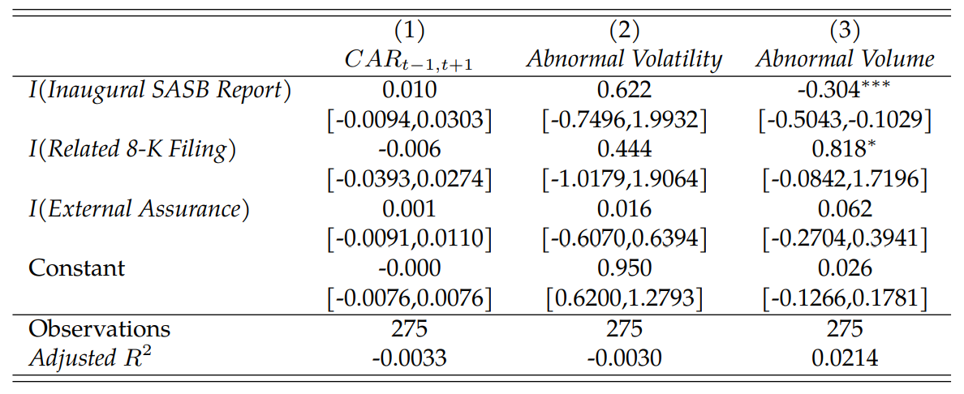
Analysis of Potential Determinants

Slide 21
Alternative Explanations
SASB metrics previously announced
Delayed price response
Metrics are typically financially immaterial
Financially material information is preempted in traditional financial reports
Primary purpose is to report material impacts on environment and society irrespective of financial materiality to the firm

Slide 22
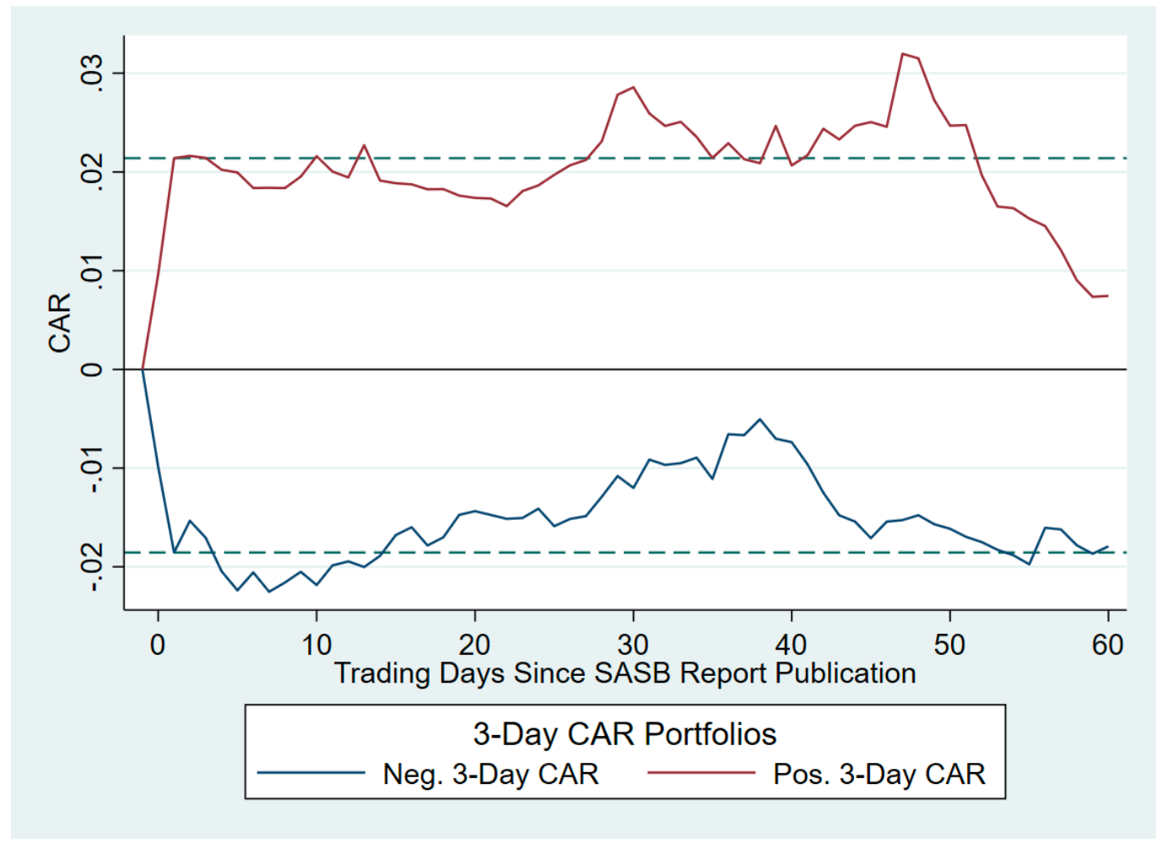
Delayed Price Response

Slide 23
Financial Materiality of SASB Metrics
SASB promulgates 993 metrics across 77 industries
The table below provides the ‘Top Ten’ metrics by frequency count based on the first 50 characters
First 50 Characters
Total amount of monetary losses as a result of leg | 68
(1) Total energy consumed, (2) percentage grid ele | 29
Discussion of long-term and short-term strategy or | 21
(1) Total water withdrawn, (2) total water consume | 19
(1) Number of data breaches, (2) percentage involv | 15
Air emissions of the following pollutants: (1) NOx | 15
Description of water management risks and discussi | 13
Number of incidents of non-compliance associated w | 13
Description of approach to identifying and address | 12
(1) Total recordable incident rate (TRIR) and (2) | 12

Slide 24
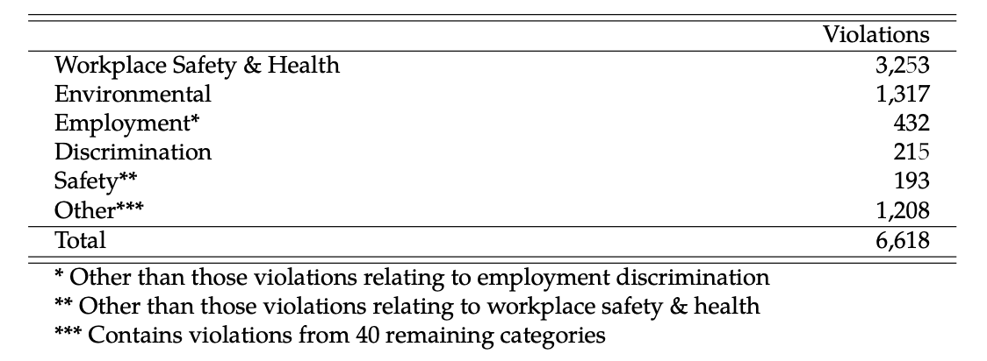
Examine Penalties Associated with Legal Violations
Analyze a comprehensive sample of violations announced during our sample period from the ‘Violation Tracker’ database provided by ‘Good Jobs First’

Slide 25
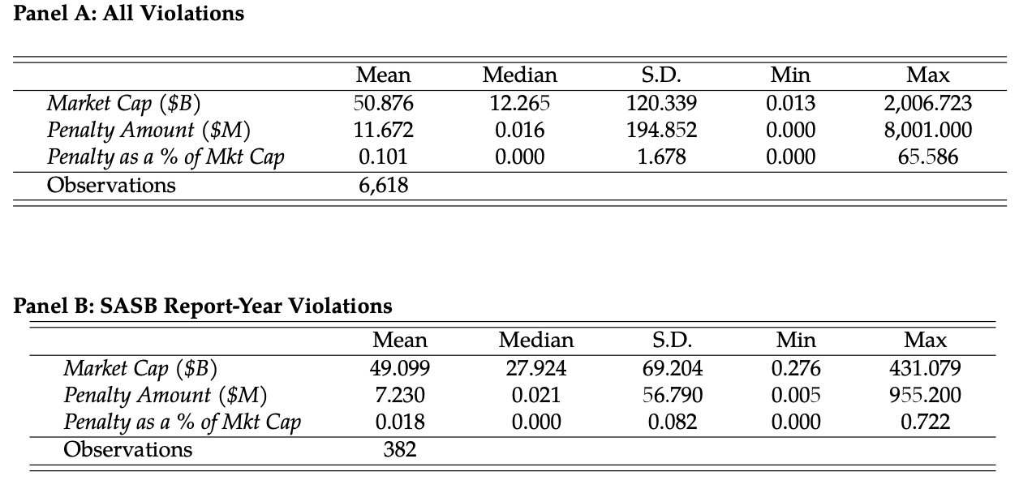
Financial Penalties Associated with Violations

Slide 26
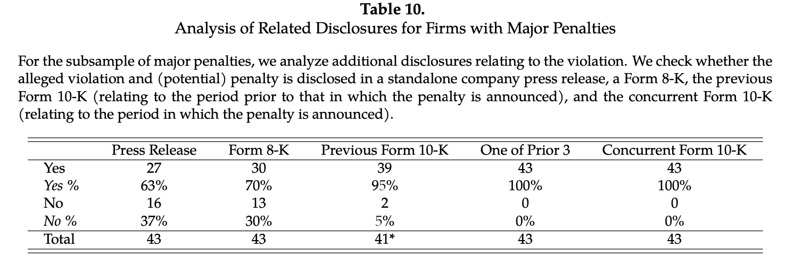
Subsample of Financially Material Penalties

Slide 27
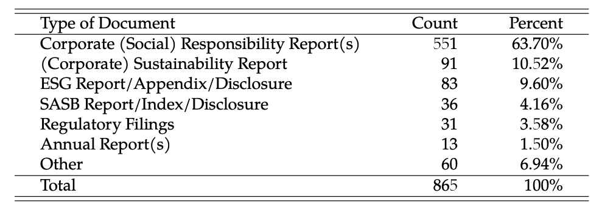
Positioning of SASB Metrics
Document Type:
Website Location:

Slide 28
Concluding Comments
We are unable to find compelling evidence of significant financial information content in sustainability reports incorporating SASB metrics.
Further tests indicate that the information contained in the reports is typically not financially material
In the few cases where it is financially material, it is preempted by other required financial disclosures, such as Form 8-K and Form 10-K.
Positioning analysis suggests that the primary purpose of sustainability reporting is to inform a broad group of stakeholders about environmental and social impacts

